Slide 1
Contact Manager Group 17

Slide 2
Team Members and Roles
Project Manager: Matthew Eisenberg
Frontend
Backend
Database
William Barrett
Jia Jones
Dennis Gorman
Ahmed Salama
Pedro Criado

Slide 3












Technology Used
Frontend
Backend
Database

Slide 4
What went well
Were in constant communication
Once a design was decided, the process of creating it came easily
Database was set up quickly

Slide 5
What did not go well
Lack of experience delayed the development process
Took some time to come to a consensus on what to include in the design and the website functionality
Had difficulty coding and testing when everyone was making changes concurrently

Slide 6
Gantt Chart

Slide 7
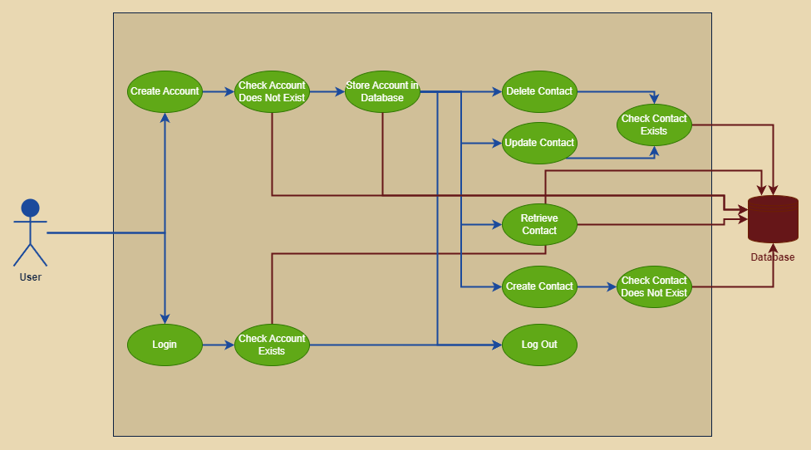
Use Case Diagram

Slide 8
Entity Relation Diagram
Logins
ID | Int
FirstName | VarChar
LastName | VarChar
UserName | VarChar
Password | VarChar
Contacts
ID | Int
UserID | Int
FirstName | VarChar
LastName | VarChar
Email | VarChar

Slide 9
SwaggerHub Demo
https://app.swaggerhub.com/apis/DENNISGORMAN02/ContactManager/1.0.4

